Slide 1


Numerical Mesoscale Modelling of Microstructures in Nickel-Based Superalloy
GUIDED BY
Dr. Jinu Paul
Dr. Arun Babu K
PRESENTED BY
SANDHRA M LAL B201054ME
THANVIR DIOUF S B201120ME
AISWARYA R B201046ME
MAMIDI MAHIMA B201140ME

Slide 2
CONTENTS
Objectives
Introduction
Cellular Automata
Methodology
Work done
Conclusion
References

Slide 3
OBJECTIVES
Create a mesoscale model using cellular automata to mimic microstructural changes in a nickel superalloy. Develop accurate constitutive equations for warm forming behaviour.
Evaluate work hardening and flow softening parameters from the stress strain curve and apply them in the CA model for microstructure prediction. Optimize equations for improved accuracy in describing alloy properties.
Validate the model against experimental data and published results to ensure accuracy.
Provide new insights into microstructural evolution for predicting material behavior, and potentially improving manufacturing processes.
Complete the modeling and validation within the span of two semesters and publish an international journal paper

Slide 4
INTRODUCTION
Ni-Based superalloys are favored in harsh environments due to their strength, corrosion resistance, thermal fatigue properties, and stability.
The excellent mechanical properties are derived from the unique combination of alloying elements Mo, Cr, N, Ni and C.
Microstructural evolution following hot working depends on - work hardening (WH), dynamic recovery (DRV) and dynamic recrystallization (DRX).
Cellular automaton is an efficient tool to study the hot working behaviour and microstructural evolution.
Intricate alloy shapes are difficult to manufacture through TMPs (Thermomechanical processing) due to flow instabilites, these can be overcome by careful control of microstructural evolution.

Slide 5
LITERATURE REVIEW
 | AUTHORS | CRITERION ADOPTED | INFERENCES
1. | K. Arun Babu, T.S. Prithiv, Abhinav Gupta, Sumantra mandal | Modeling and simulation of dynamic recrystallization in Super austenitic stainless steel employing combined Cellular Automaton, Artificial neural Network and Finite element method | The development of a Cellular Automaton (CA) model for predicting dynamic recrystallization (DRX) in super austenitic stainless steel to improve accuracy by considering solute drag effects, enhancing predictions of DRX and flow behavior.
2. | K. Arun Babu, Sumantra Mandal, Abhishek Kumar, C.N. Anthreya, B.De Boer, V. Subramanya Sarma | Characterization of Hot deformation behavior of alloy 617 through kinetic analysis, dynamic material modeling, and microstructural studies. | The study on alloy 617's hot deformation behavior while noting unexpected dynamic recrystallization at higher temperatures and strain rates.

Slide 6
LITERATUE REVIEW
 | AUTHORS | CRITERION ADOPTED | INFERENCES
3. | Yan-Xing Liu, Zhi-Jiang Ke, Run-Hua Li, Ju-Qing Song, Jing-Jing Ruan | Study of Grain Growth in a Ni-Based Superalloy by Experiments and Cellular Automaton Model. | The study reveals that in a Ni-based superalloy, grain growth during isothermal heat treatment is influenced by temperature, with the developed Cellular Automaton (CA) model effectively describing the kinetics and size dependence.
4. | Yan-Xing Liua, Y.C. Lina, Ying Zhoua | 2D cellular automaton simulation of hot deformation behavior in a Ni-based superalloy under varying thermal-mechanical conditions | A 2D cellular automaton model successfully predicts the hot deformation behavior of a Ni-based superalloy, uncovering a novel phenomenon, "pseudo-metadynamic recrystallization," during rapid strain rate changes.

Slide 7
LITERATURE REVIEW
 | AUTHORS | CRITERION ADOPTED | INFERENCES
5. | R. Ding, Z.X. Guo | Microstructural modelling of dynamic recrystallisation using an extended cellular automaton approach | A cellular automaton model is used to simulate dynamic recrystallization in a titanium alloy, linking mesoscopic dislocation behavior to macroscopic mechanical properties.

Slide 8
GAPS IN LITERATURE
Most studies are focused on the hot deformation of alloys under constant strain rates and temperatures.
Only a few studies investigate the hot deformation behaviour under varying conditions.
Most of the studies have created a 2-D cellular automaton model to describe hot deformation behaviour, we will be developing a 3D model.

Slide 9
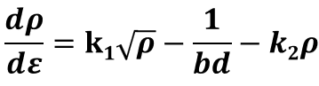

METHODOLOGY
The variation of dislocation density (𝜌) during straining is expressed based on Kocks-Mecking (KM) relation as following
𝜀 is the plastic strain, 𝑑 is the average grain size,𝑘₁ is the hardening parameter, 𝑘₂ is the softening parameter and 𝑏 is the burger vector.
The flow stress could be correlated to plastic strain based on the relation as given
𝜇 is the shear modulus, 𝛼 is a constant (~0.5) and 𝜌 is the average dislocation density

Slide 10
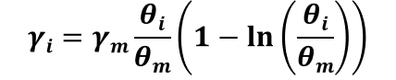
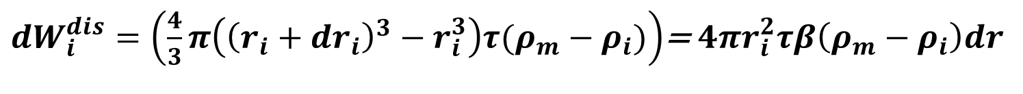
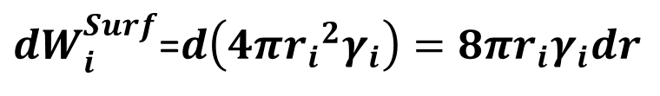
Read-Shockley relationship for incorporating misorientation angle (θ) effect on boundary energy
𝛾_{𝑖} boundary energy of a i^{th} boundary with 𝜃_{𝑖}, 𝜃_{𝑚} ~15º
The net force on the boundary (𝐹_{𝑖}) is evaluated by the following relation
𝜌_{𝑚} is the dislocation density of the matrix, 𝜌_{𝑖} is the dislocation density, 𝑟_{𝑖} radius of the i^{th} grain, 𝜏=0.5 Gb² boundary line energy where G is shear modulus and b is burgers vector, 𝛾_{𝑖} boundary energy (misorientation dependent).

Slide 11

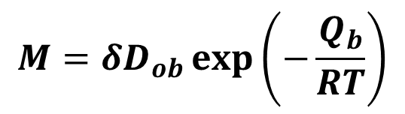

Boundary pressure Boundary velocity
Variation of boundary mobility with temperature is described by the following relation
INPUTS TO THE CA MODEL
Temperature
Strain rate
OUTPUT OF CA MODEL
Flow curve
Final DRX grain diameter
DRX fraction

Slide 12
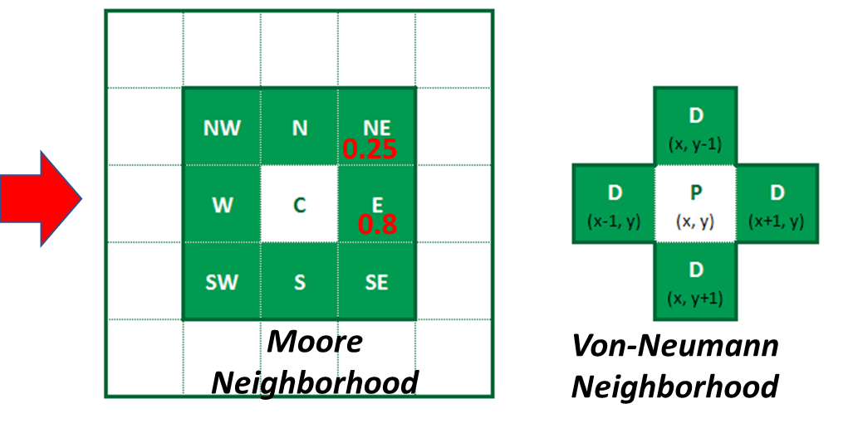
CELLULAR AUTOMATON (CA)
n-dimensional homogeneous grid consisting of cells with discrete number of states
Cells change state as the result of a transition rule
Transition rule is defined in terms of the states of cells that are part of a neighbourhood and previous time step
Growth of DRX grains can be simulated by CA.
Fig1. neighbourhood in a cellular automaton

Slide 13
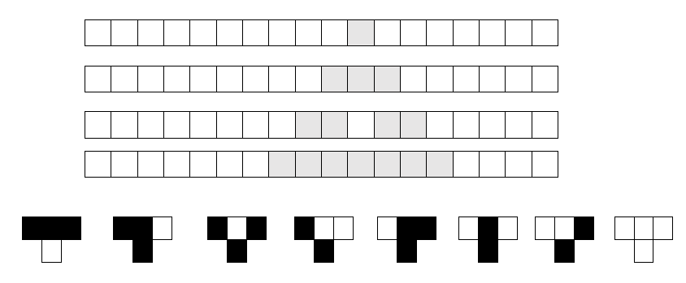
CELLULAR AUTOMATON
3 Black = White
2 Black = Black
1 Black = Black
3 White = White
Fig2. Rule 30 cellular automaton

Slide 14
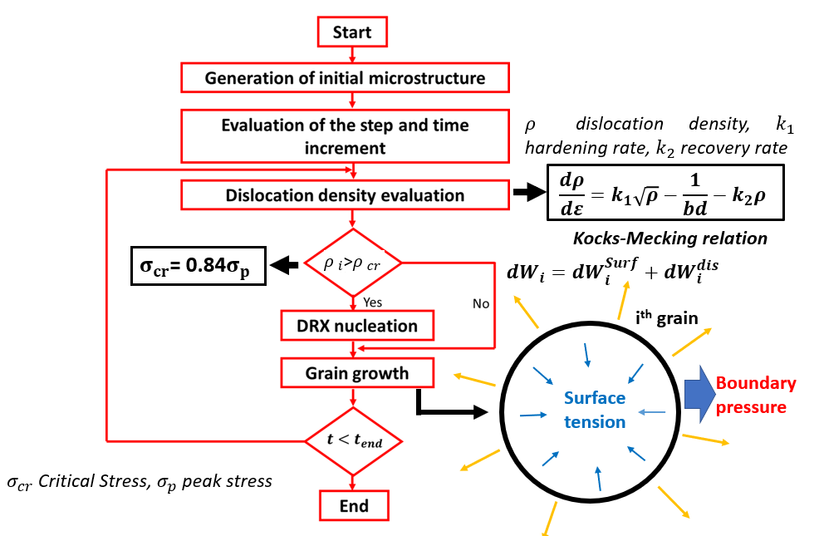
DRX SIMULATION - NUMERICAL SCHEME
Fig3. Flow chart of a cellular automaton simulation

Slide 15
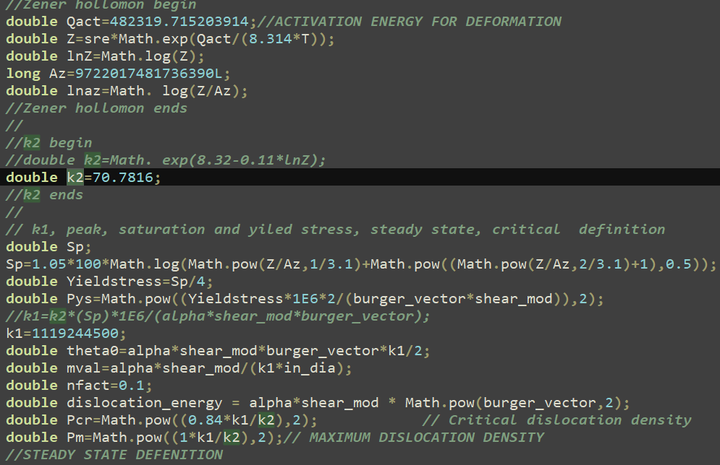

Slide 16
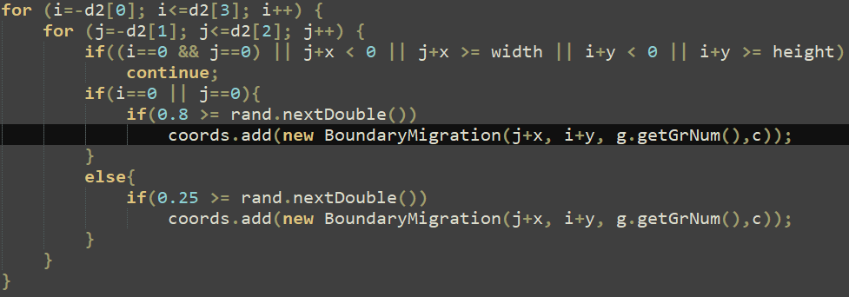

Slide 17


Slide 18
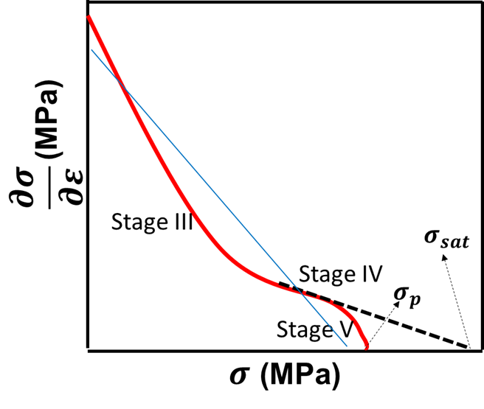
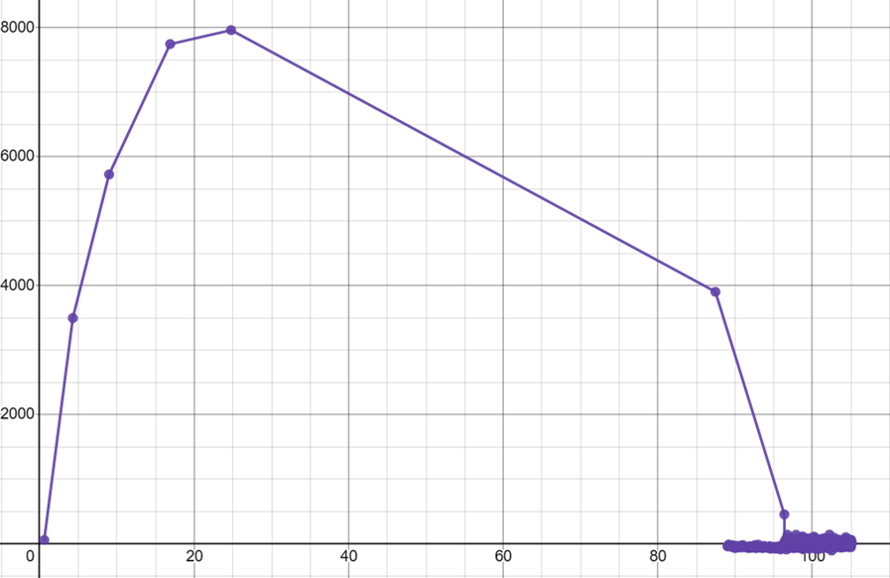
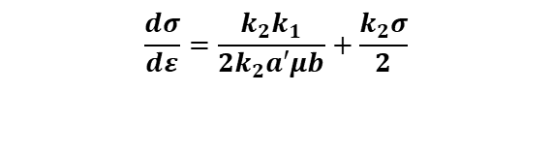
Modelling of work hardening and softening parameters
$$\frac{dσ}{dε}=\frac{k_{2}k_{1}}{2k_{2}a′μb}+\frac{k_{2}σ}{2}$$
Fig4. Schematic illustration of Kocks-Mecking plot
Fig5. obtained Kocks-Mecking Plot

Slide 19
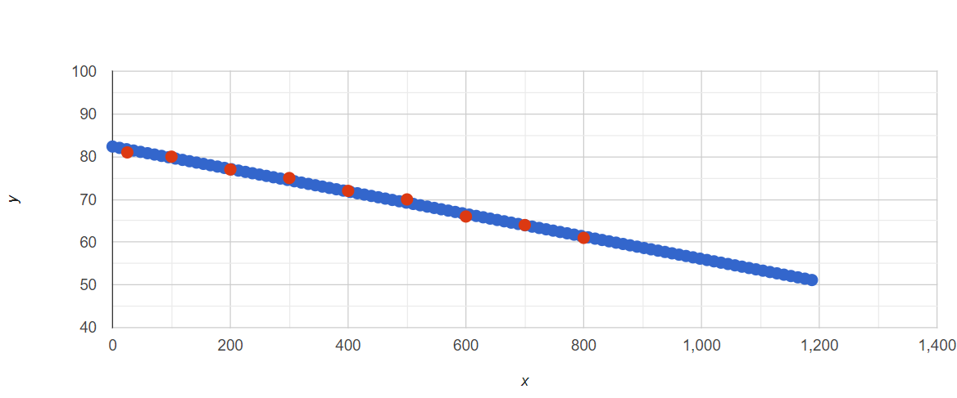
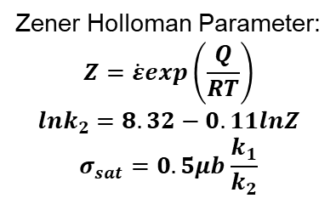
Zener Holloman Parameter:
$$Z=\dot{ε}exp\left(\frac{Q}{RT}\right)$$
$$lnk_{2}=8.32−0.11lnZ$$
$$σ_{sat}=0.5μb\frac{k_{1}}{k_{2}}$$
Fig 6. Variation of shear modulus and temperature

Slide 20
WORK HOURS
To learn Java 8-10 hours each
Learning the theory required for the calculations. 10-12 hours
Hand calculations 1-2 hours

Slide 21
WORK REMAINING
Converting the 2D CA model to 3D CA model.
Coupling the optimized CA model with ANN or FEM to get better and more accurate results.
Writing a journal paper on the same.

Slide 22
REFERENCES
[1].K. Arun Babu, T.S. Prithiv, A. Gupta, S. Mandal, Modeling and simulation of dynamic recrystallization in super austenitic stainless steel employing combined cellular automaton, (2021) .
[2]Ding, Ruoxi & Guo, Z. Xiao. Microstructural modelling of dynamic recrystallisation using an extended cellular automaton approach. Computational Materials Science.(2002)
[3].Yan-Xing Liua, Y.C. Lina, Ying Zhoua, 2D cellular automaton simulation of hot deformation behavior in a Ni-based superalloy under varying thermal-mechanical conditions.(2017)
[4].Yan-Xing Liu, et.al, Study of Grain Growth in a Ni-Based Superalloy by Experiments and Cellular Automaton Model.(2021)
[5] Babu, K. A., Mandal, S., Kumar, A., Athreya, C., De Boer, B., & Sarma, V. S. Characterization of hot deformation behavior of alloy 617 through kinetic analysis, dynamic material modeling and microstructural studies. Materials Science and Engineering (2016).

Slide 23
THANK YOU

